Slide 1
Dynamic Programming

Slide 2
Time-Space Tradeoffs
Gaining Time:
Input Enhancement: save time by preprocessing input
Prestructuring: Use extra space to facilitate more flexible access.
Dynamic Programming
Gaining Space:
Compression Algorithms

Slide 3
Dynamic Programming
Technique for solving problems with overlapping subproblems.
Store subproblem solutions, save recomputing.
Create table of subproblem solutions (often all).
“Programming” doesn’t refer to coding
Technique came from mathematics
Problems involving multi-stage planning
“Programming” meant “planning”

Slide 4
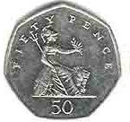
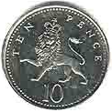
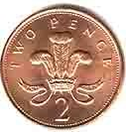
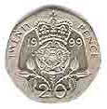
Example: Coin-Row Problem
There is a row of n coins whose values are positive integers c₁, c₂, …, c_{n}, not necessarily distinct. Your goal is to pick up the maximum amount of money subject to the constraint that no two coins adjacent in the original row are picked up.

Slide 5
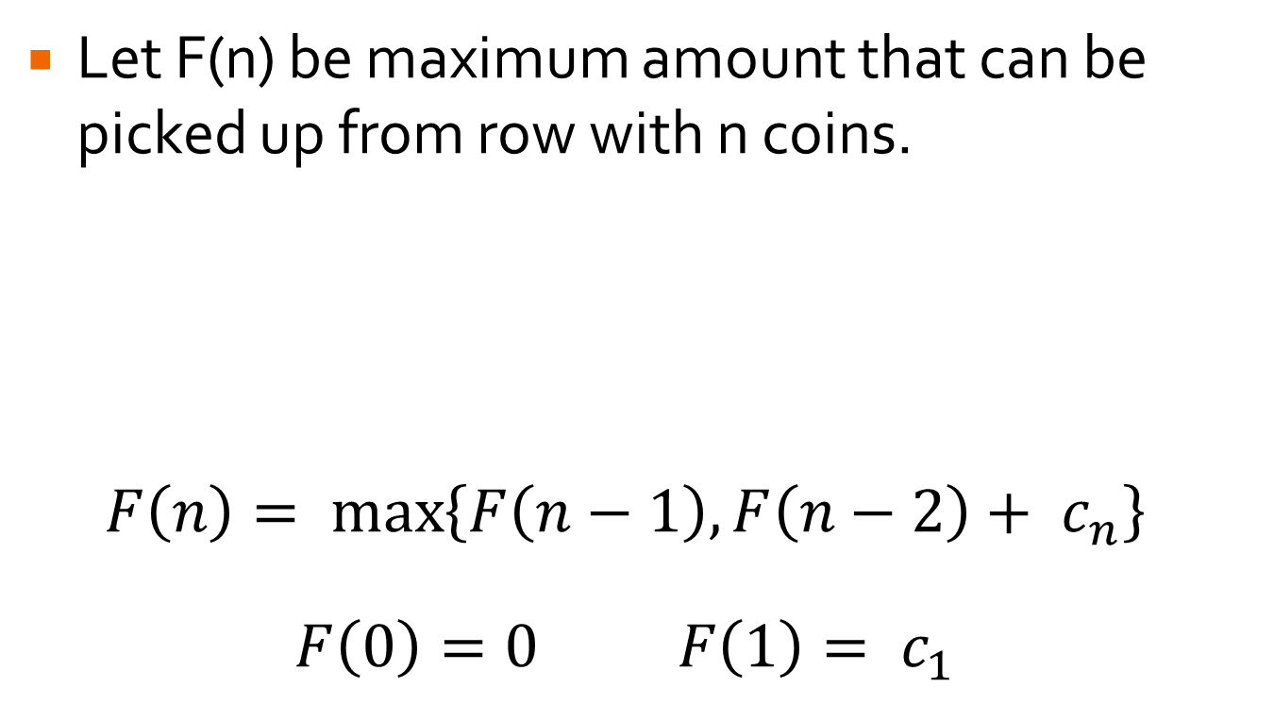
Coin-Row Problem
Let F(n) be maximum amount that can be picked up from row with n coins.
$$F\left(n\right)= \max_{}\left\{F\left(n−1\right), F\left(n−2\right)+ c_{n}\right\}$$
$$F\left(0\right)=0 F\left(1\right)= c_{1}$$

Slide 6
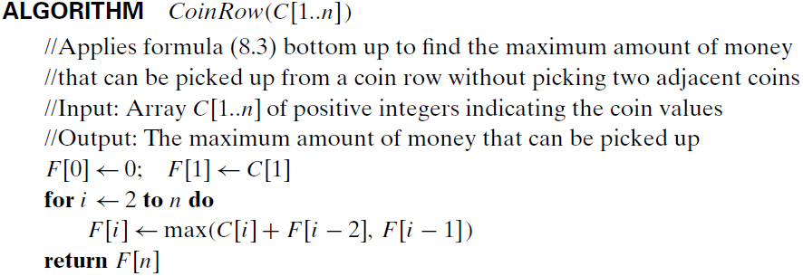
Coin-Row Algorithm
Apply algorithm to following coins

Slide 7
Coin-Row Algorithm
To get coins to pick up, would need to have second table storing whether c_{i} was included in F(i)

Slide 8
Performance
Θ(n)
Vastly superior to brute force enumeration of subsets: Θ(2^{n})

Slide 9
Your Turn …
Solve the following problem with DP: Given a sequence of n real numbers A[1] ... A[n], determine a contiguous subsequence A[i] ... A[j] for which the sum of elements in the subsequence is maximized.

Slide 10
Your Turn …
Solve the following problem with DP: Given a sequence of n real numbers A(1) ... A(n), determine a contiguous subsequence A(i) ... A(j) for which the sum of elements in the subsequence is maximized.
Solution Video: https://people.cs.clemson.edu/~bcdean/dp_practice/dp_1.swf

Slide 11
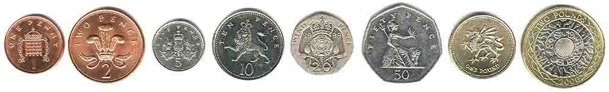
Change Making Problem
Give change for amount n using the minimum number of coins of denominations d₁ < d₂ < … < d_{m}. Assume unlimited coins of each denomination and that d₁ = 1.

Slide 12
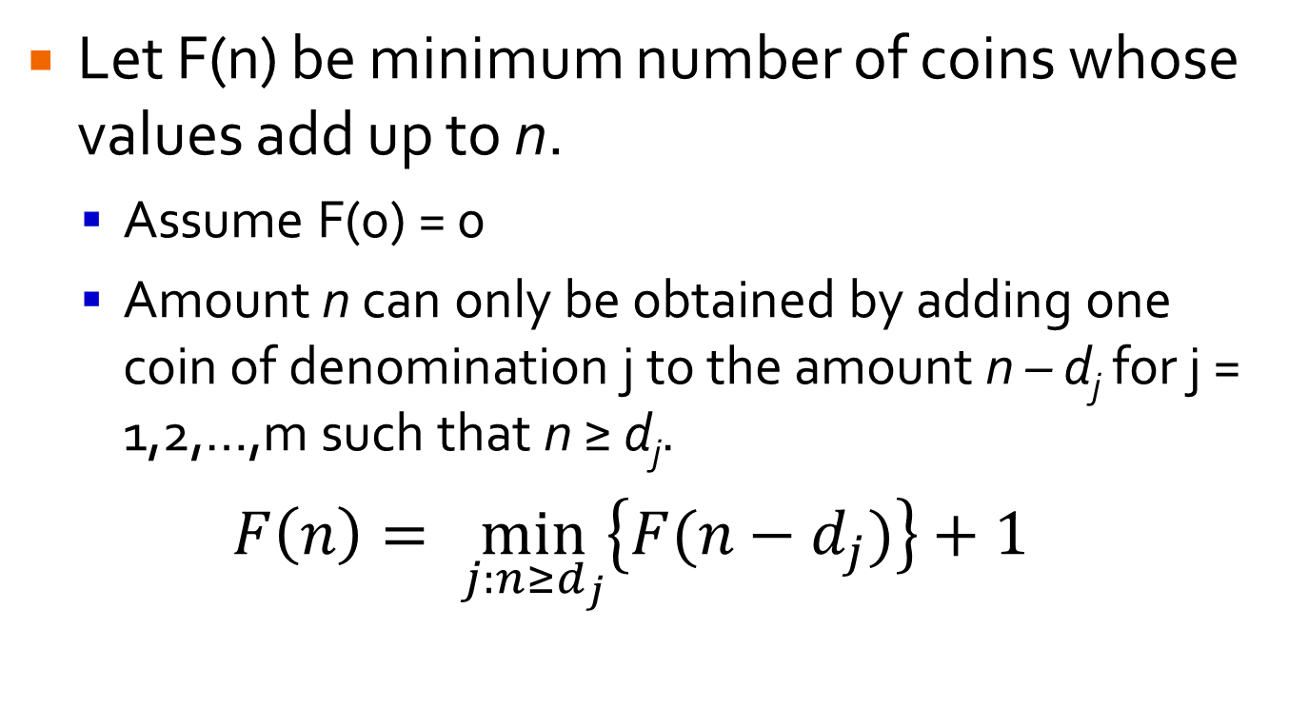
Change Making Problem
Let F(n) be minimum number of coins whose values add up to n.
Assume F(0) = 0
Amount n can only be obtained by adding one coin of denomination j to the amount n – d_{j} for j = 1,2,…,m such that n ≥ d_{j}.
$$F\left(n\right)= \min_{j:n≥d_{j}}\left\{F(n−d_{j})\right\}+1$$

Slide 13
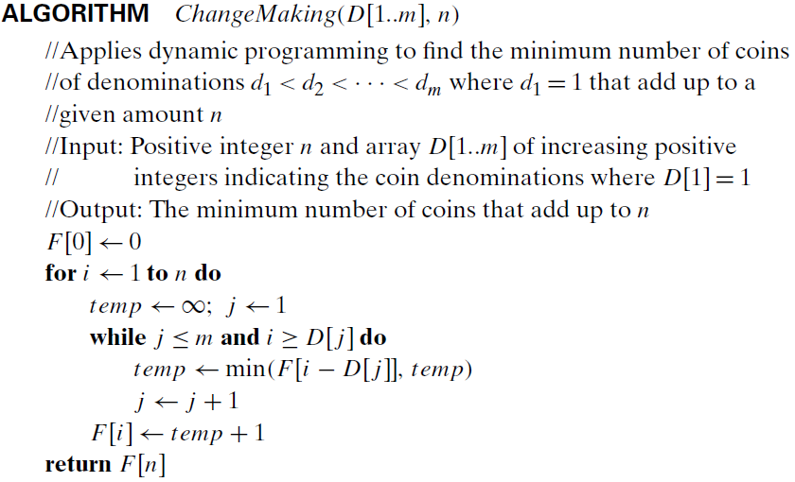
Change Making: Θ(nm)
Find minimum number of coins needed when n = 10 and denominations are 1, 3, 4.

